Slide 1
Min Graph Coloring

Slide 2
Decision Vs Exact
Decision
The decision version focuses on whether a solution exists within a fixed constraint (number of colors).
Exact version
The Exact version not only finds a solution but also minimizes the number of colors used.

Slide 3
Decision output compared to Exact output
Vertices | Edges | Decision Time (with four colors or less) | Exact Runtime
9 | 20 | 0.04 | 0.06
9 | 25 | 0.04 | 0.06
9 | 30 | 0.35(fail) | 3.35

Slide 4
Certifier being used in the Decision implementation
Certifier(graph, coloring):
for each node in graph:
for each neighbor of node:
if coloring[node] == coloring[neighbor]:
return False # Invalid coloring
return True # Valid coloring
Why it's polynomial
We iterate over all edges to ensure no two adjacent nodes are the same color
O(E) E = edges in the graph
The certifier only validates one given coloring

Slide 5
3SAT Reduction
(x1 V x2 V ~X3) /\ (~x1 V ~x2 V x3)
X1
~x1
Vertices created: 2V + E
Edges Created: V + 3E
Total Operations: O(V + E)
C1
X2
~x2
C2
~X3
x3

Slide 6
Runtime Analysis
Runtime for each method
Input parsing
O(E)
Check Valid Coloring
O(V + E)
Find Min Coloring
O(n^n*(V+E))
In Total O(n^n*(V+E))

Slide 7
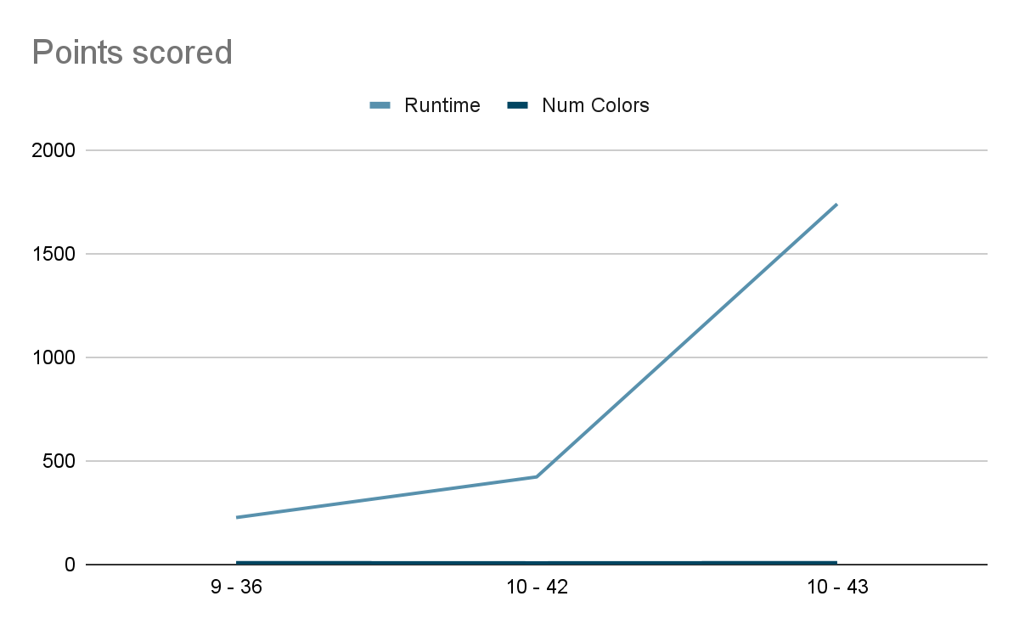
Time in
seconds
Edges - Vertices

Slide 8
